Slide 1

Going from Program Improvement to Program Successful!
Presenters:
Mr. Ami Sandler, Ms. Suzanne Harriger, &
Mr. Robert Reynolds

Slide 2
some History of our school—
A. B. Miller High School, fontana, ca
We opened in 1992, the second HS in the growing city of Fontana.
We immediately had to overcome the step-child syndrome; we were the “other” HS. (The original HS in town, Fontana HS, was still being referred to as “THE” high school – even by DO personnel 5 years after our opening!)
By 1996 we were recognized by the DOE as a
“California Distinguished School”
We had developed our own identity of academic success with a strong, hand-picked staff (one of the benefits of being a new school) and with the advent of a new school-wide program, Career Pathways.

Slide 3
Career pathways
We developed 32 different Pathways, each leading to an actual certificate awarded upon graduation. Some students valued these more than their diplomas!
The 32 Pathways were spread across the following 5 focus areas (much like the current CTE sectors): Arts & Communication, Applied Technology & Engineering, Business Services & Marketing, Health & Environmental Sciences, and Social, Human, & Governmental Services.
In addition to the completion of coursework, students would also participate in seminars put on by community professionals who had careers in their focus areas. This could lead to job-shadowing fieldtrips – which, in turn, could lead to internships.

Slide 4
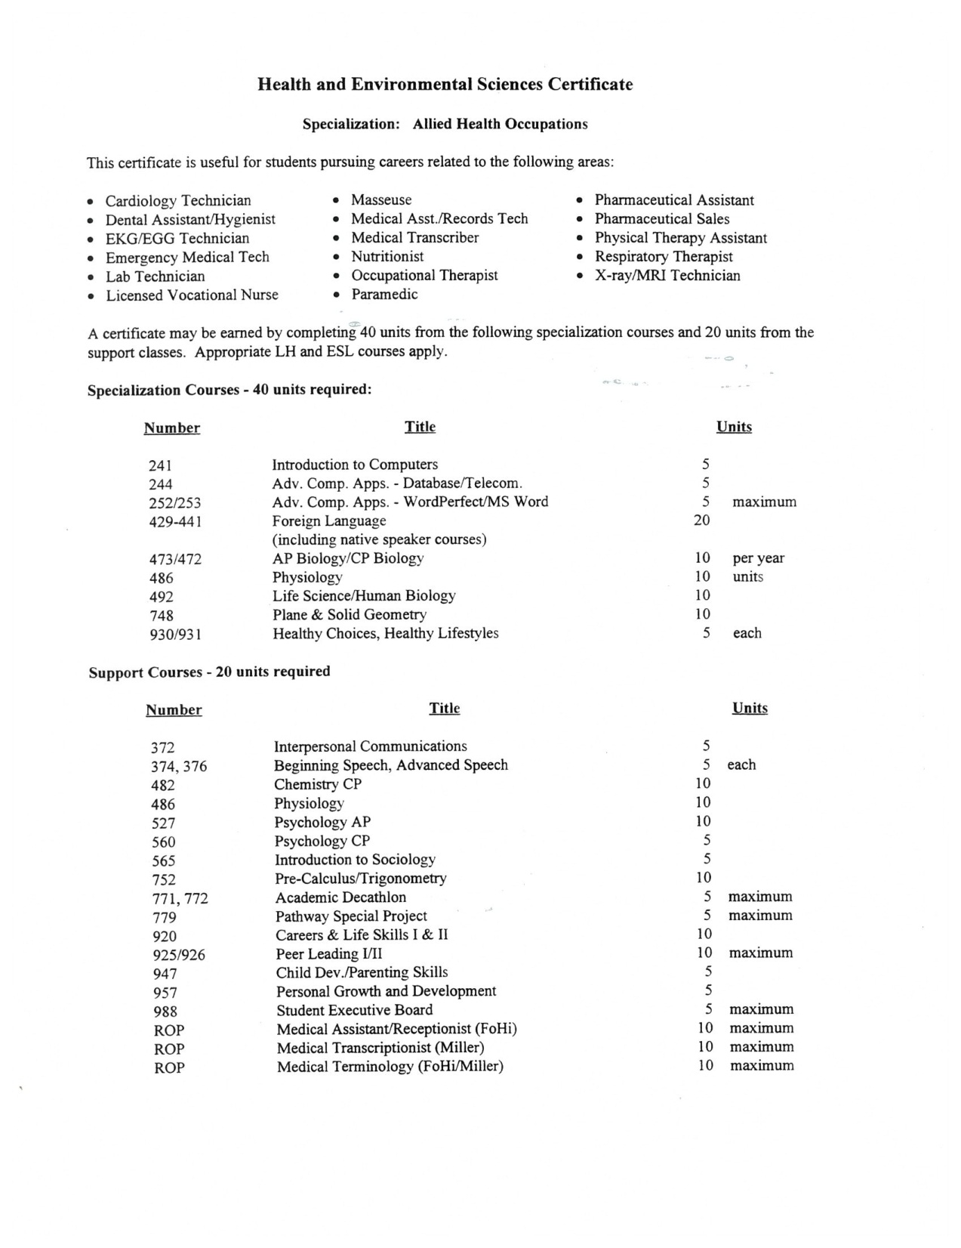

Slide 5
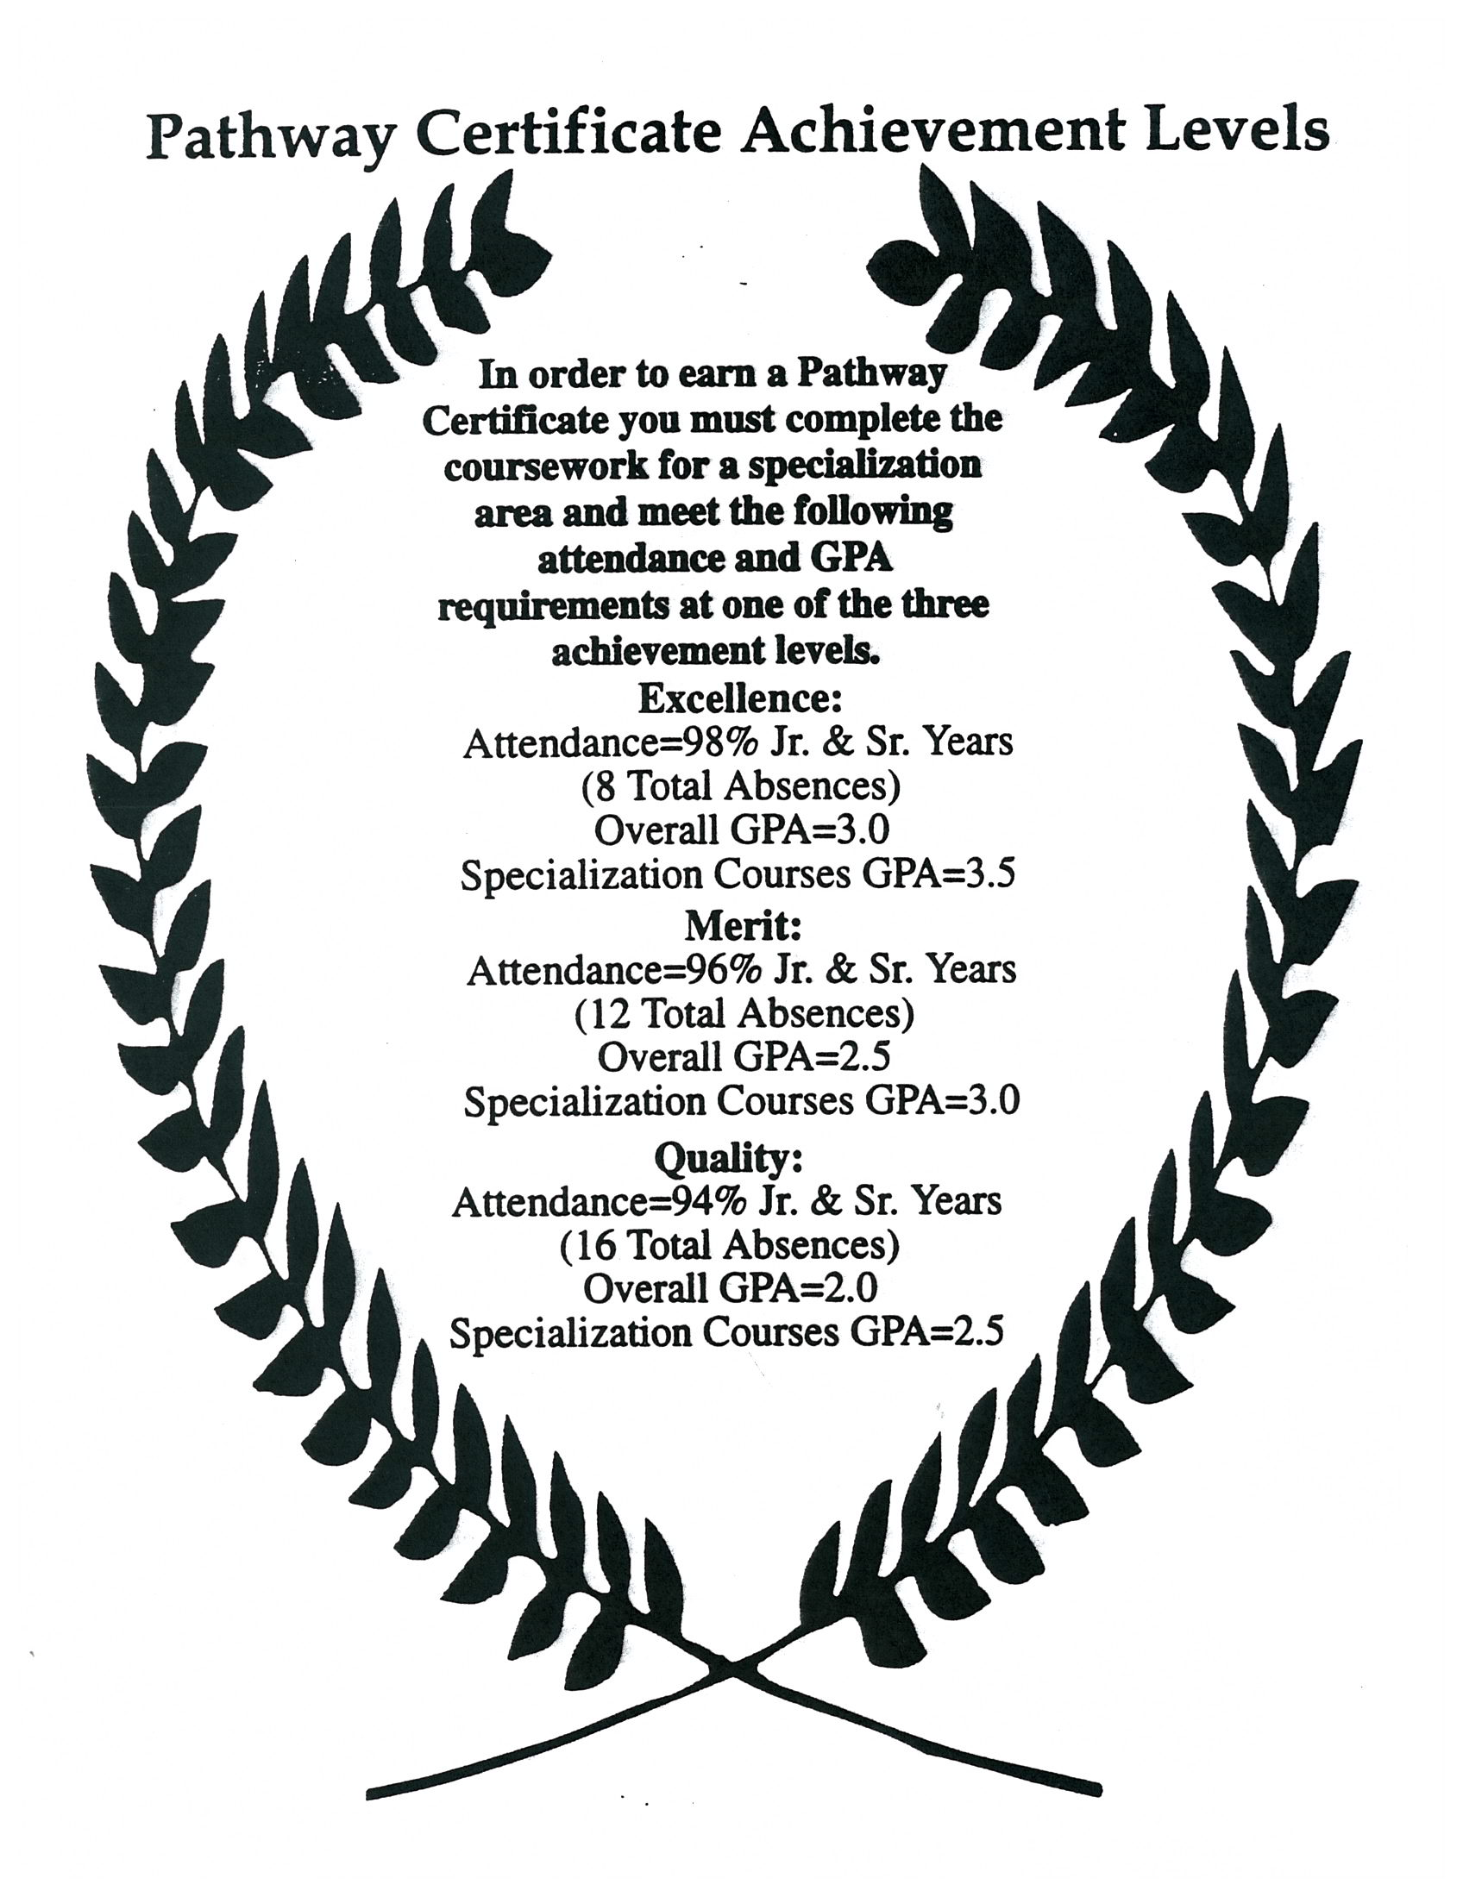

Slide 6
We were on top of the world!
We were “cutting edge!”
We were the model of change!
What could possibly go wrong?!
Well….

Slide 7
PROGRAM IMPROVEMENT!!!

Slide 8
What led to our Downfall?
Possible (probable?) key issues:
Since 1999, Fontana Unified has opened 3 new high schools.
Since 2000, there have been 6 different superintendents (2 were interim)
(…and the kicker)
Since 1998, (In just 14 years) A. B. Miller HS has endured 9 different principals and 57 vice principals!

Slide 9
Normally, when a school enters PI, there is a drastic change in the site administration. Because our current principal had only been with us for a year, she was able to stay – as long as we came up with a plan to drastically change what we had come to know as the regular school day.
We applied for, and were awarded, a School Improvement Grant (SIG). Things were going to be different….

Slide 10
Life under the sig
A seven-period day
Teacher incentives
Additional staff
Increased student incentives/activities
Staff development
Staff bonding activities
More personal contact with parents (report card pick-up)

Slide 11
one of the more consistent programs during this “roller coaster?”
ACADEMIES!
Protective Services Academy (ran from ‘99 to ‘10)
Teacher Education Academy @ Miller (2004 to present)
and our most successful & longest running academy…
Health Services Academy (2002 to present)

Slide 12
So…
In this popular Health Services Academy -- are these academy students really any more successful than their peers?
You be the judge….

Slide 13
CST Results
CST Percent Proficient 2011/12
2012 ELA
FUSD* | A.B. Miller High School | Health Services Academy
42% | 44% | 63%
2012 Math
FUSD* | A.B. Miller High School | Health Services Academy
18% | 21% | 36%
2012 Science
FUSD* | A.B. Miller High School | Health Services Academy
50% | 50% | 71%
(*High Schools Only)

Slide 14
CAHSEE Results
CAHSEE Percent Passed 2011/12 - ELA
FUSD | A.B. Miller High School | Health Services Academy
80% | 81% | 97%
CAHSEE Percent Passed 2011/12 - Math
FUSD | A.B. Miller High School | Health Services Academy
78% | 82% | 100%

Slide 15
Graduation Rate
Cohort Graduation Rate 2011**
FUSD | A.B. Miller High School | Health Services Academy
81% (10-11 Year) | 82% (10-11 Year) | 100% (10-11 Year)
**Graduation rates are always calculated a year behind. 2011-12 data not available yet.

Slide 16
Average GPAs
GPA Averages for 2011-12 Year (End of Semester 2)
FUSD | A.B. Miller High School | Health Services Academy
10th Grade
2.29 | 2.38 | 3.25
11th Grade
2.45 | 2.52 | 3.08
12th Grade
2.58 | 2.58 | 2.99

